Slide 1

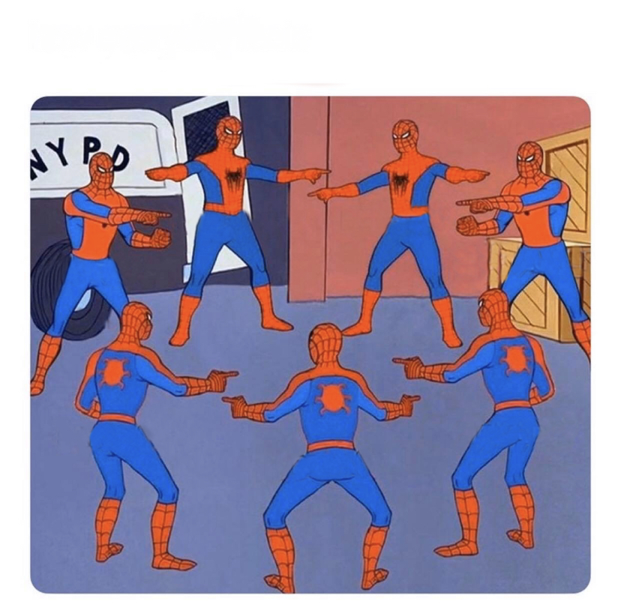
De - Duping
A GitHub original

Slide 2
Agenda
What is De-Duping?
Why do we de-dupe?
De-Duping steps
Activity
What industries to look out for (with examples)

Slide 3
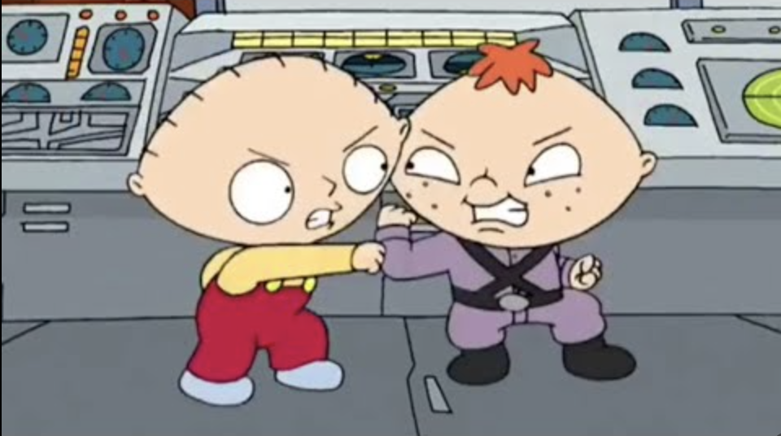
Definition
De-Duping is the process of removing identical entries from two or more data sets within SFDC

Slide 4

Why do we De-Dupe
When booking meetings with Reps, this is a huge source of income for everyone involved - including you!
“you do not want to mess with their livelihoods”
-A cool manager
Notes:
Reps take a lot of time to prepare for meetings and to have the meeting. They can loop in other team members like SEs early in discussions which can prove burdensome from a cost/time perspective if they are not the right individuals

Slide 5
Steps
Search full company name in SFDC
Look at tasks filter by due date. If activity <45 days reach out to that person with activity. (If SEBR don’t pursue but transfer)
Search company name without "inc" or similar
Search company domain in SFDC
Search Crunchbase with [NAME OF COMPANY] + parent company.
Also include a step for trying slight variations. If a company has multiple words in the name, try just the first word and see what auto populates.

Slide 6
Keep in mind
Add “” in SFDC to get exact searches.
Remember ROE! (different leads = ok (if not SEBR))
EDU has its own RR with the same CSRs
EDU accounts have a deal with GH whereas they receive unlimited seats for spending $50k with us.
If it’s an oned account always reach out to the AM, most of the time they want it but still defer to the Rep.
If there’s open opps in SFDC sync with opportunity owner to get context on it.

Slide 7
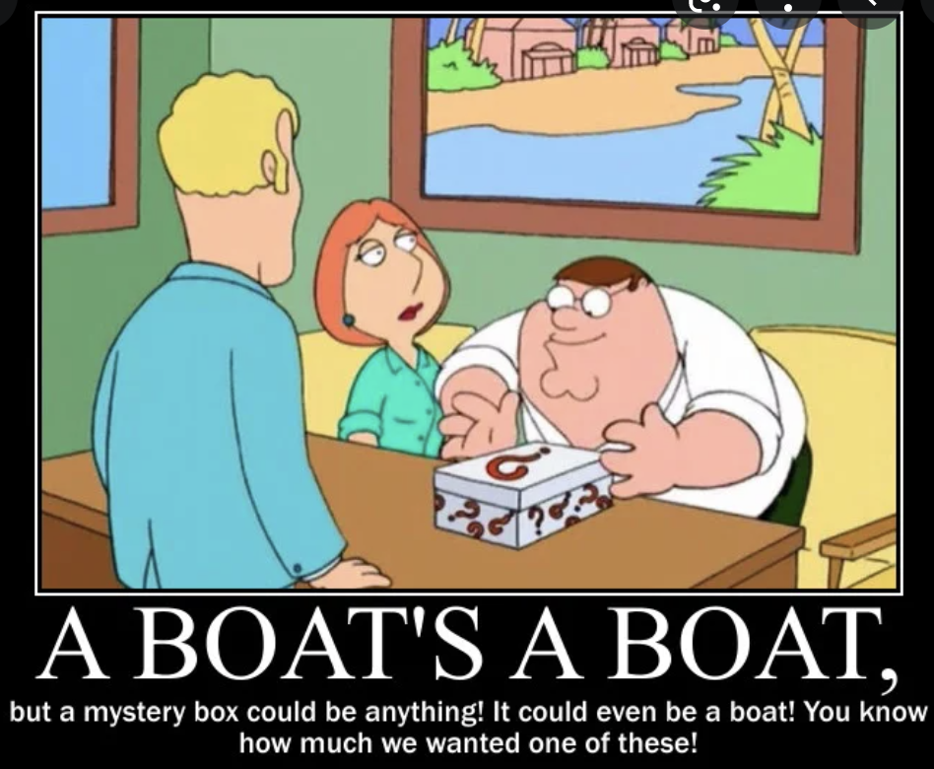
Mystery Industry 1
Achieveit
“That’s why everyone from global corporations to regional healthcare systems to federal government have turned to AchieveIt for their Integrated Plan Management.”
No duplicates
Crunchbase showing as private
Guess?

Slide 8
Answer
“Private entity with public sector customers.”
Next step:
Round Robin

Slide 9
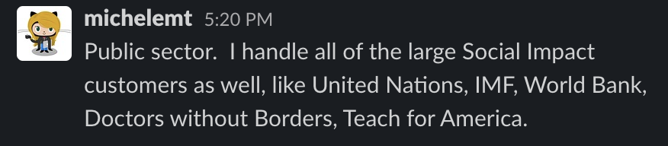
Alion Science and Technology
Owned by Michele Thompson. Last renewal in 2018
Naval Architecture & Marine Engineering, Systems Analysis, Design & Engineering, Modeling, Simulation, Training & Analysis, Artificial Intelligence, and LVC Training
A: “We would need security requirements implemented within a government cloud solution.” (Air Force contractor)

Slide 10
Farmers’ Edge
Crunchbase: HQd in Canada
Mission statement and customer base: revolutionizing the way farmers, agricultural professionals, and agri-businesses interact with data.
Activity: No SEBR activity in the past 45 days. No activity with same lead.
No duplicates.
22 users on Teams
137 on GitHub Enterprise
AM = Jeff Cook (set for)

Slide 11
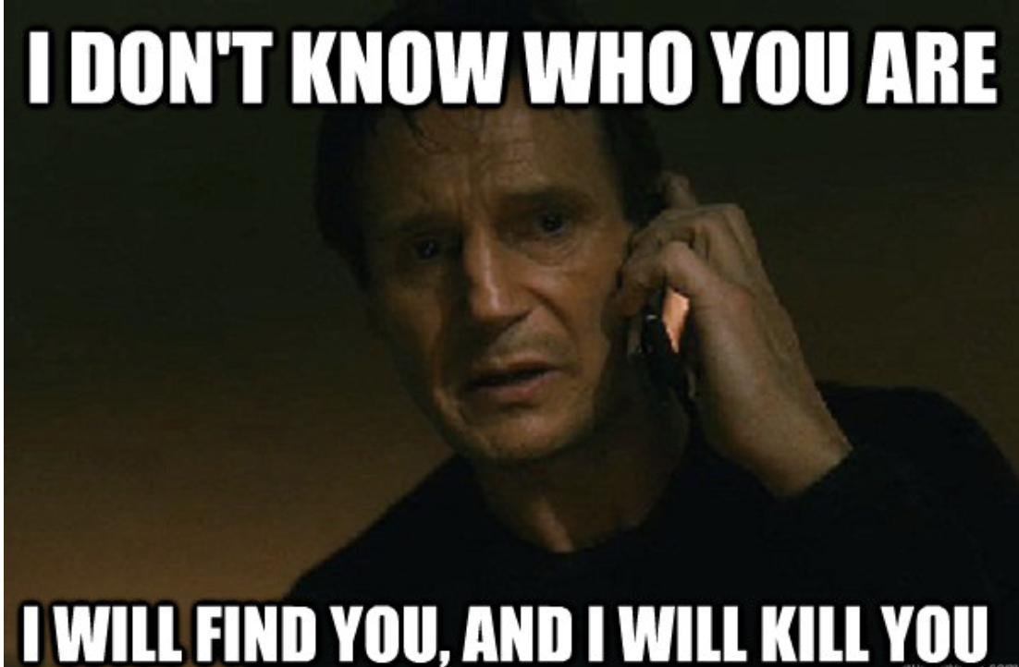
IDB Consulting
Crunchbase: Headquartered in California however, contact says this is for their site in Peru.
RR (great time to sync with them on this with this information in mind.)
Activity: No activity for this lead in the last 45 days
Linkedin is showing as privately owned in Paris however, Crunchbase shows in California.
Multiple HQs would just mean to call them and verify.
0 users on GitHub (net - new)

Slide 12
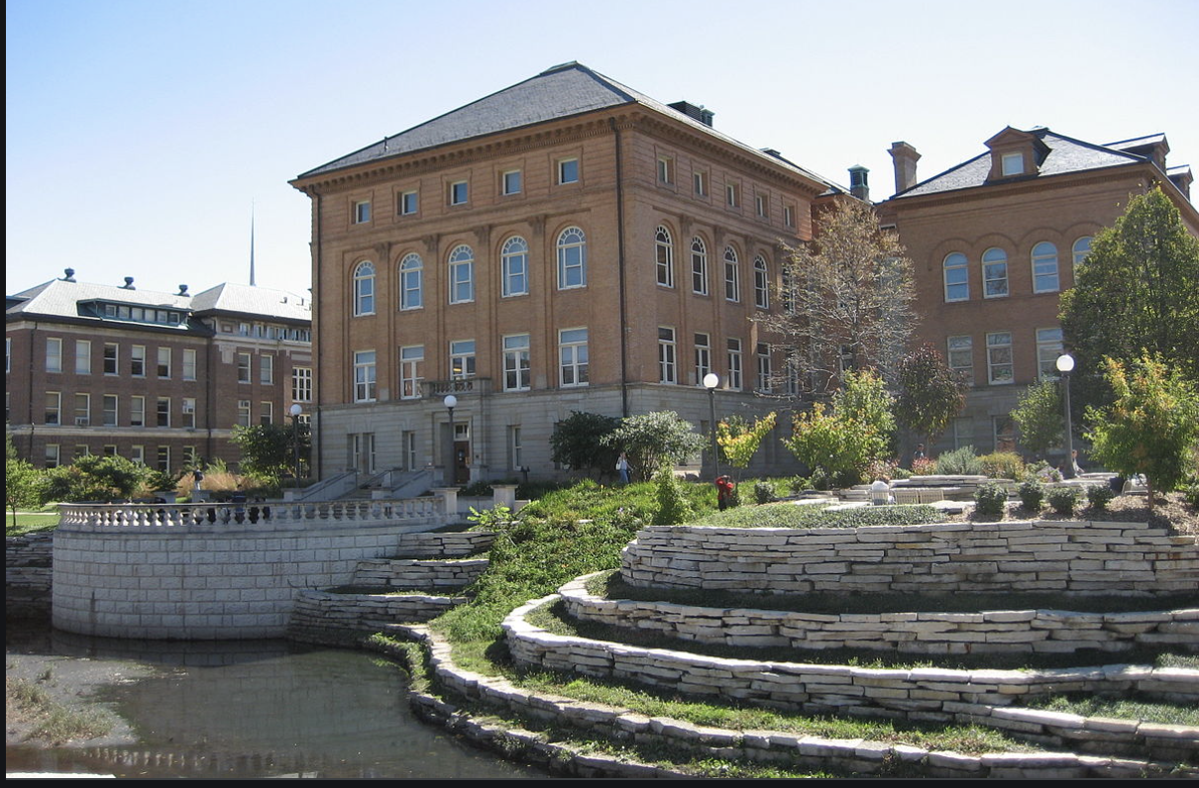
*Bonus* EDU
University of Illinois College of Engineering (Parent)
$45 k deal so could fall into unlimited seat deal (sync with Rep)
AM = Vincent Leoni
No duplicates
50k+ seats

